Slide 1
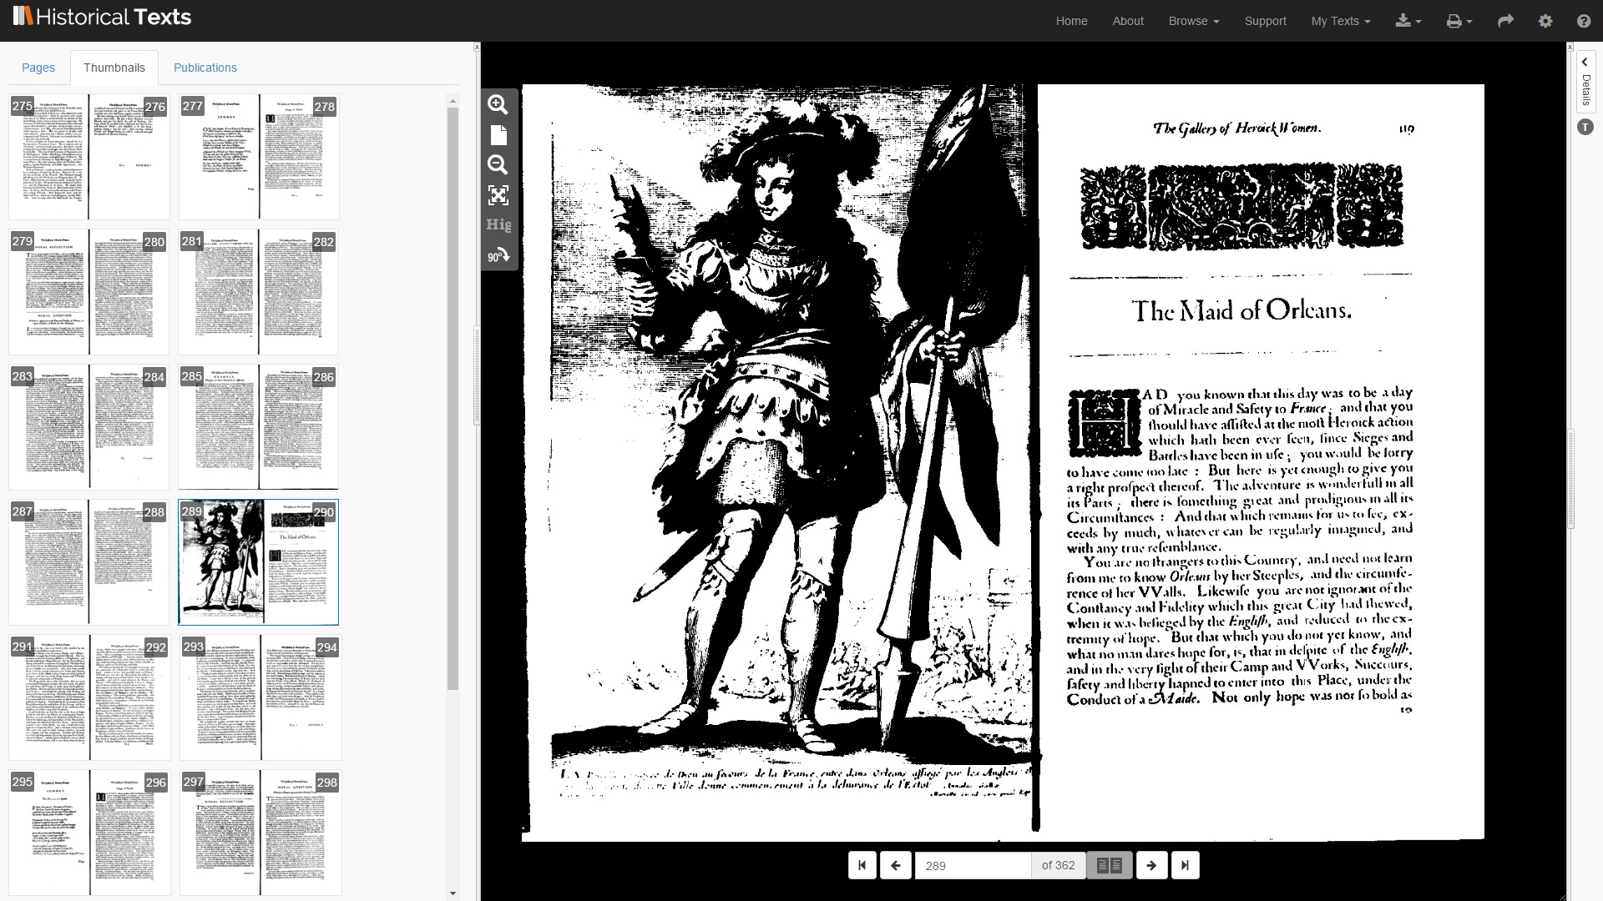

Introduction to Historical Texts
Over 480, 000 late 15th to long 19th century texts
(EEBO, ECCO, BL 19th Century and UK Medical Heritage Library)

Slide 2
What is Historical Texts?
Historical Texts is a full text digital archive enabling you to cross search, view and download over 480,000 texts published in the late C15th to the long C19th.
It is comprised of four main collections:
Early English Books Online (EEBO) (1473-1700)
Eighteenth Century Collections Online (ECCO) (1701-1800)
65,000 texts from the British Library 19th Century collection (1789-1914)
66,000 texts from the UK Medical Heritage Library (primarily C19)
Including a wealth of content ranging from the Romantic to the Victorian period and coverage subject areas including English literature, history, geography, science, social science, religion and medicine.
Materials include books, pamphlets, sermons, almanacs, sheet music, broadsides and newsbooks.

Slide 3
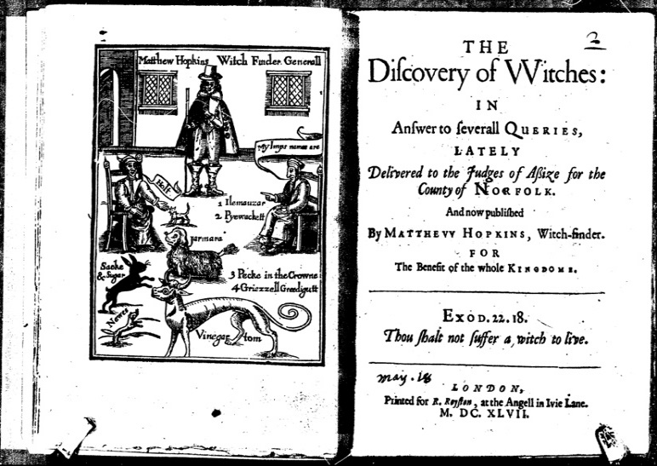
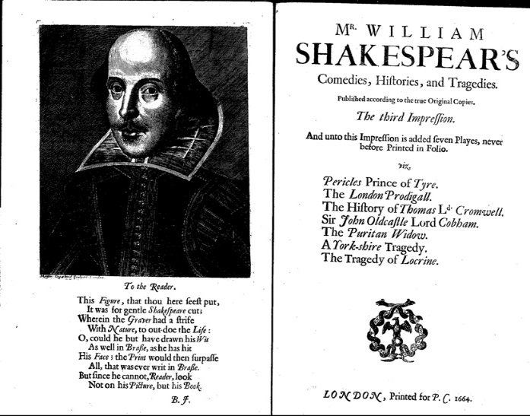
Early English Books Online (EEBO)
(1473-1700)
The scanned images, and full-text digital versions where available, of over 130,000 books printed in Britain and British North America, and works in English printed elsewhere, from the first book published in England up to 1700.
Authors include Shakespeare, Galileo, Bacon, Chaucer, Spenser and Margaret Cavendish.

Slide 4
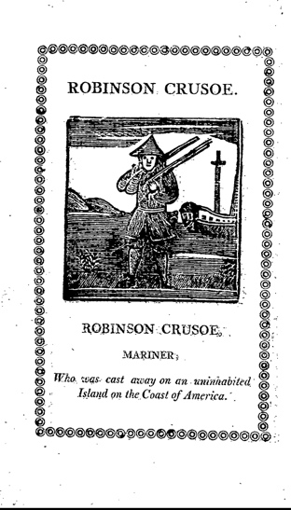
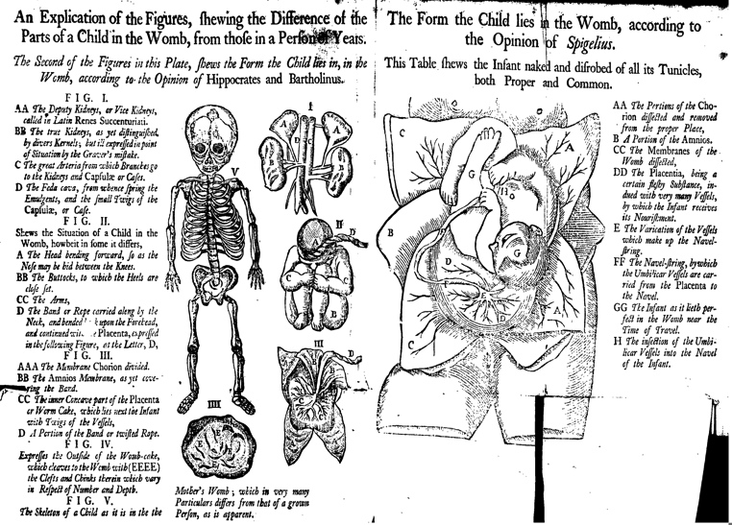
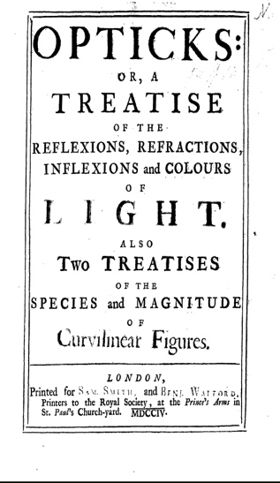
Eighteenth Century Collections Online (ECCO)
(1701-1800)
A digital collection of more than 215,000 titles published in Great Britain and its colonies during the eighteenth century, including works in languages other than English (e.g. French, German, Latin and Welsh)
Works include Daniel Defoe, Newton, Culpepper, Alexander Pope, Thomas Paine, Voltaire.

Slide 5
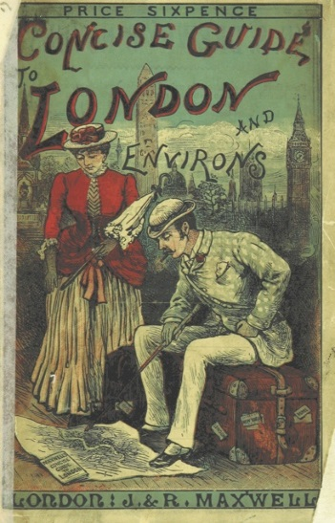
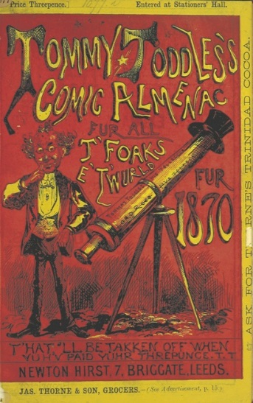
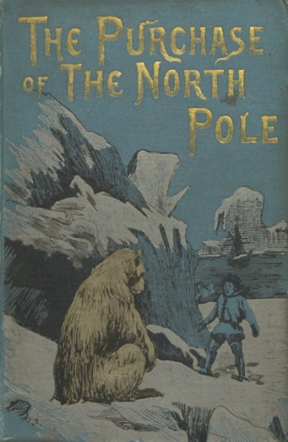
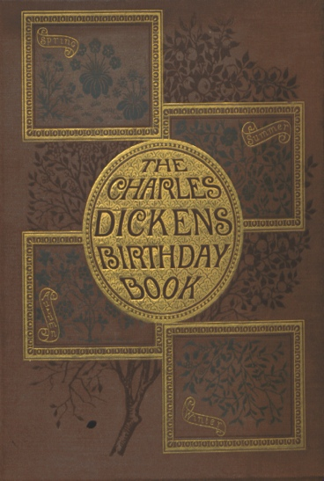
65,000 British Library 19th century texts (BL)
(1789-1914)
Over 65,000 recently digitised editions from the British Library's 19th century collection, comprising over 25 million pages of previously rare and inaccessible titles.
Authors include Jane Austen, Charles Dickens, Jules Verne

Slide 6
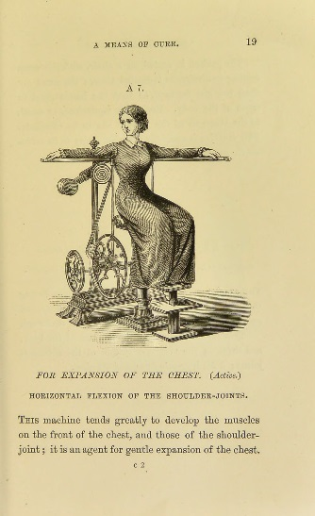
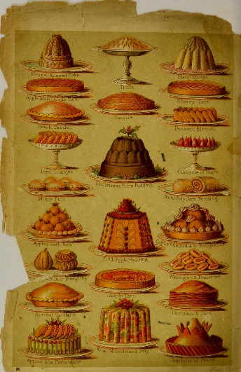
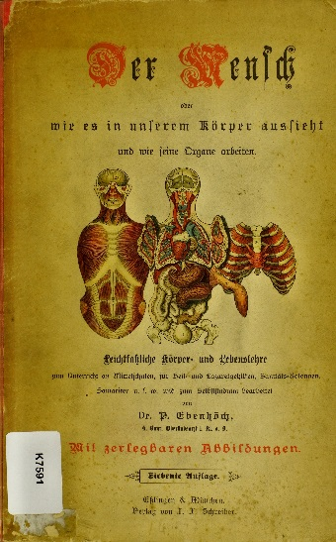
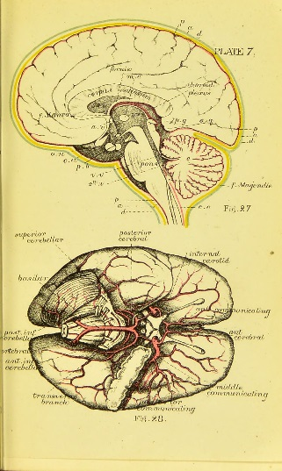
UK Medical Heritage Library Collection (UKMHL)
Over 66,000 digitised European medical publications from the nineteenth century
The collection has now been integrated into the main platform but remains open access
Full colour page images, PDF, ePub and OCR full text are downloadable for all publications in this collection

Slide 7
Key features
Cross-search EEBO, ECCO, 65, 000 texts from the British Library C19th collection and the UK Medical Heritage Library from the same platform
Search across both open access and subscription content
View and search the full text (where available) as well as the bibliographic information for texts
View images and full text side by side
Download whole publications (PDF) and individual images (JPEG).
View publication date histogram for search results
Additional download options for TCP-transcribed texts (ePub, XML, HTML, plain text)

Slide 8
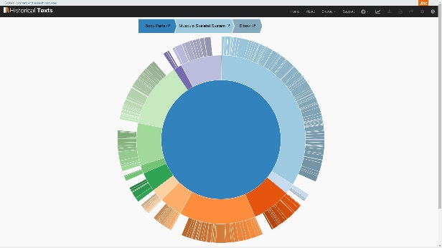
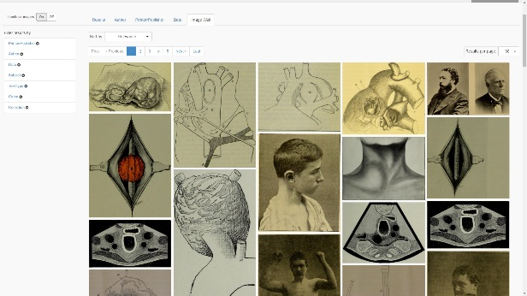
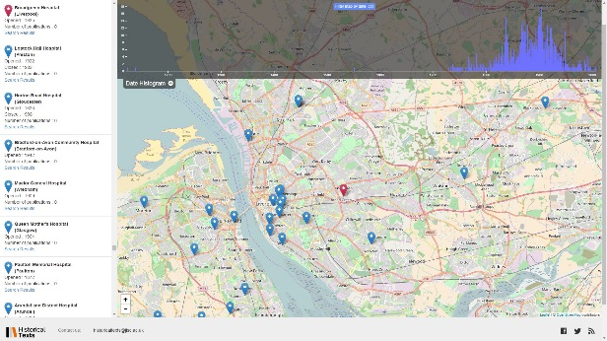
Historical Texts Labs – Visualising Medical History project (VMH)
Bespoke visualisation tools built specially for the UKMHL collection in a sister project will continue to be available on the separate UKMHL labs site (ukmhl.historicaltexts.jisc.ac.uk)
The available visualisations are: Image Wall, Hospital Map, Ngram Viewer, Timeline, Sunbursts and Dendrograms
Facilitate new ways to explore the collection data

Slide 9
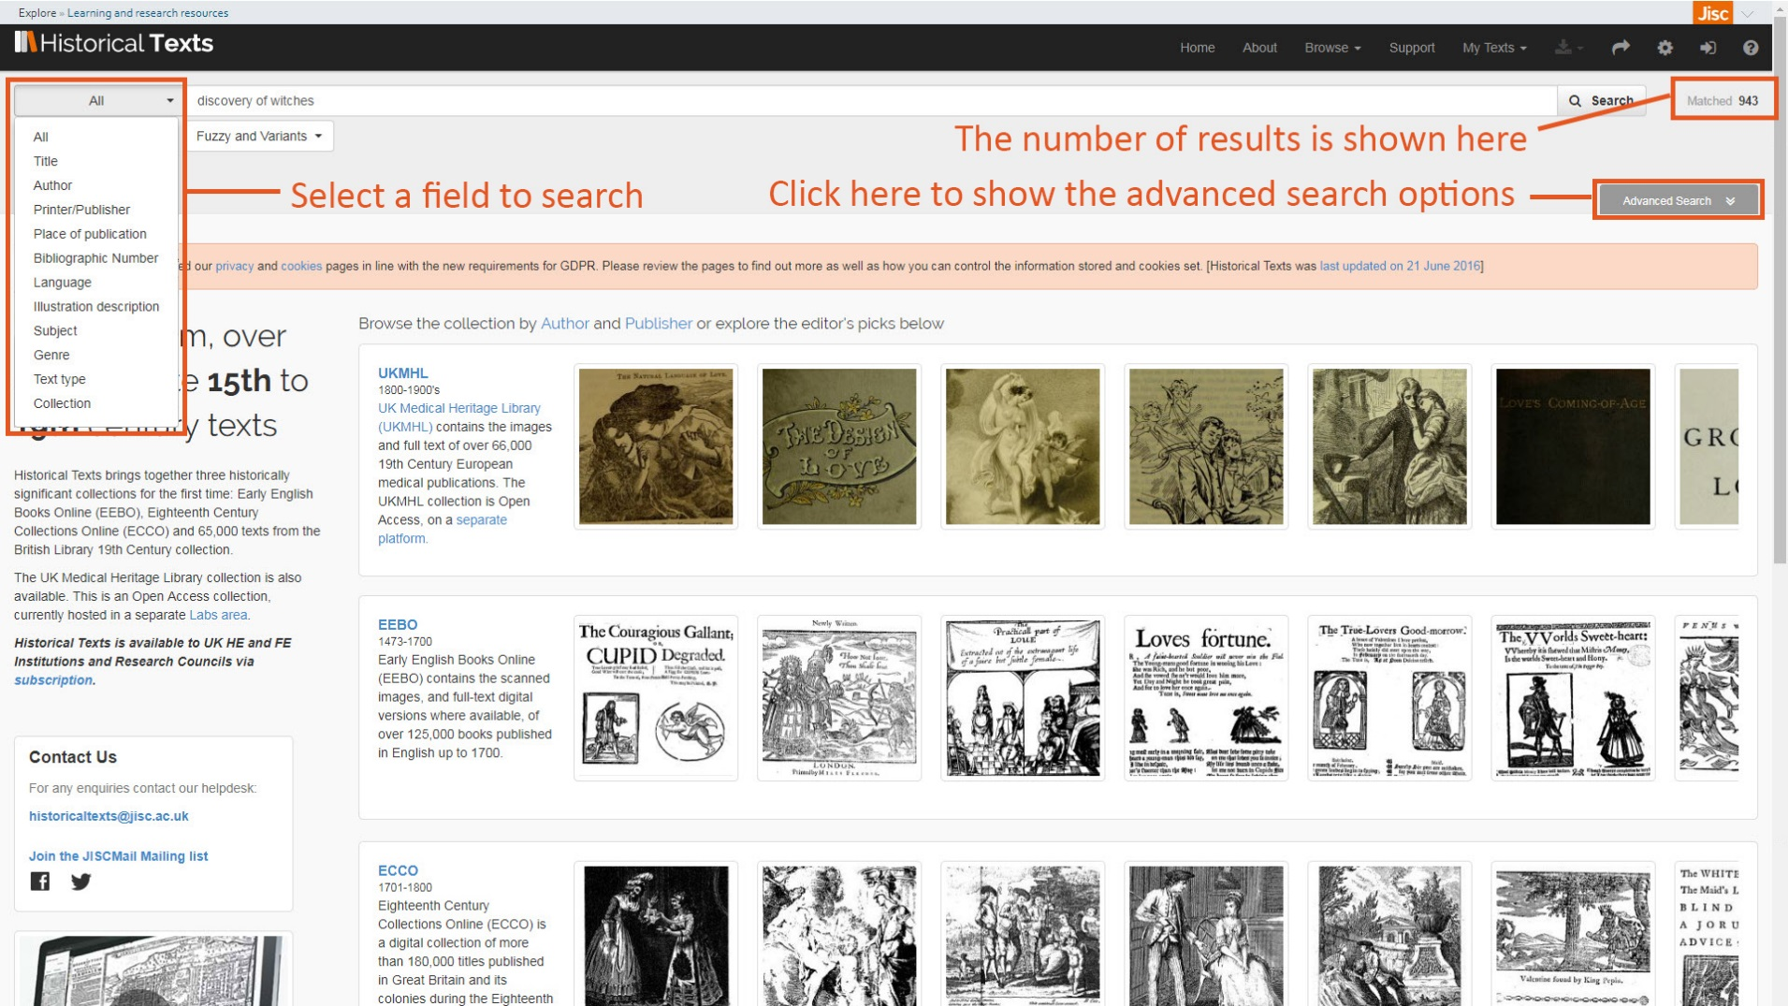
Search

Slide 10
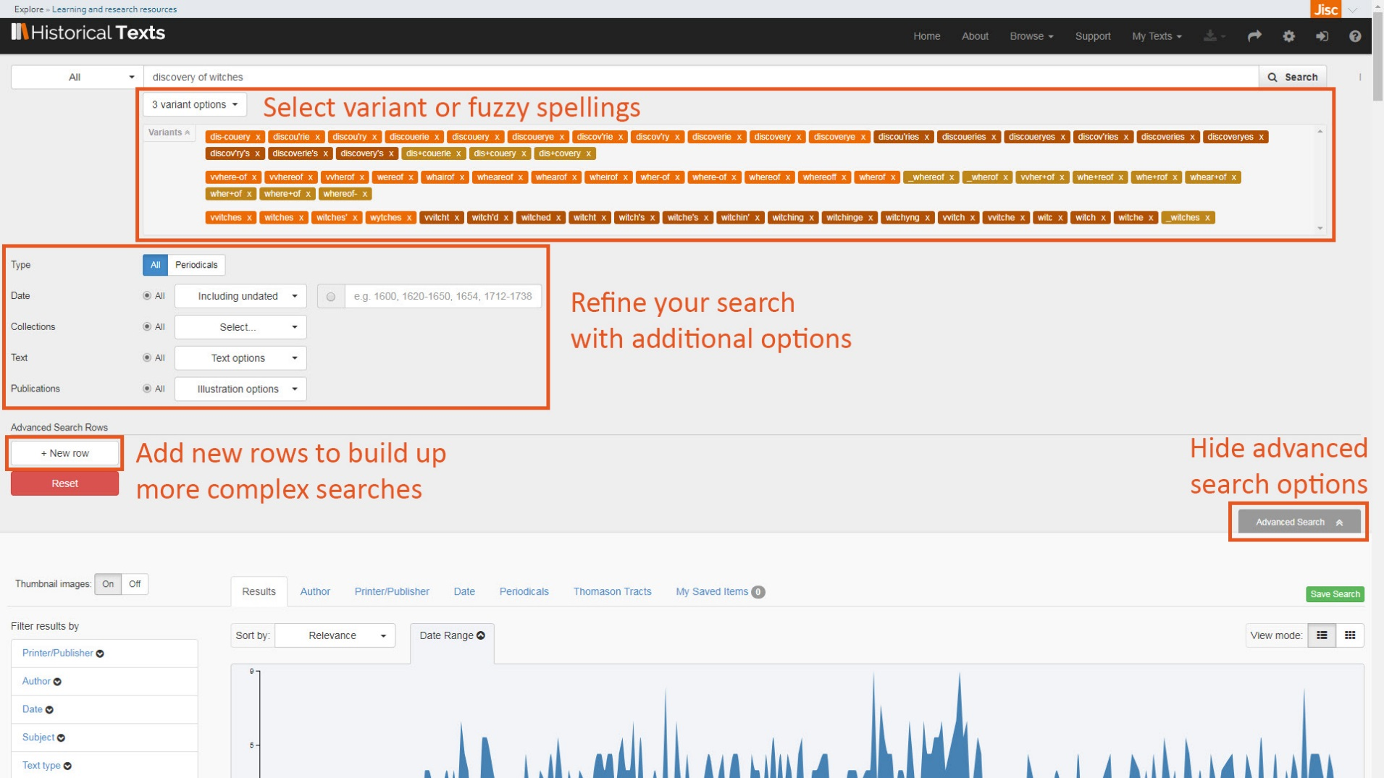
Advanced search

Slide 11
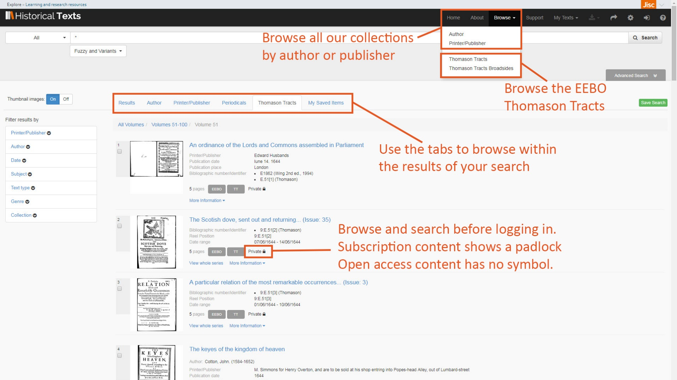
Browse

Slide 12
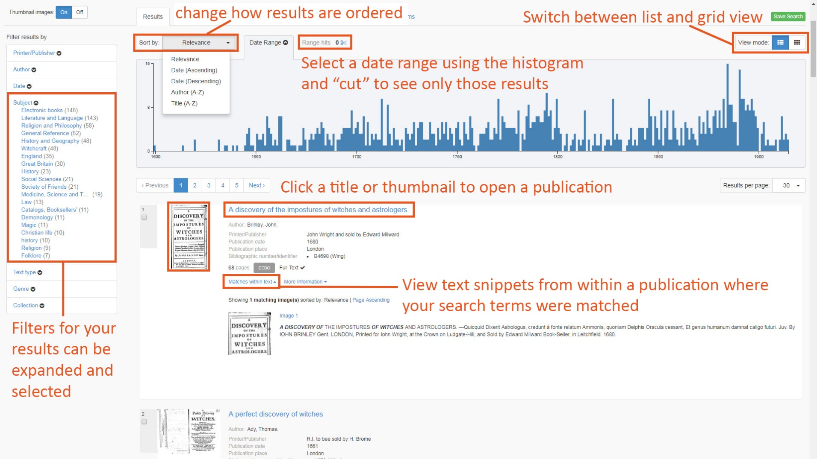
Results

Slide 13
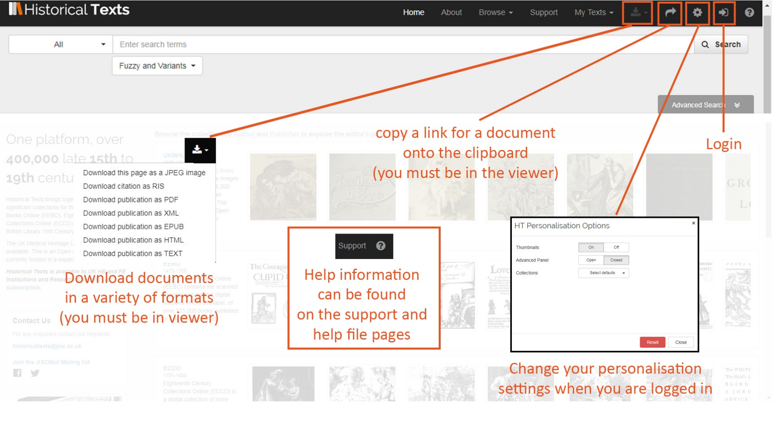
Settings and toolbar

Slide 14
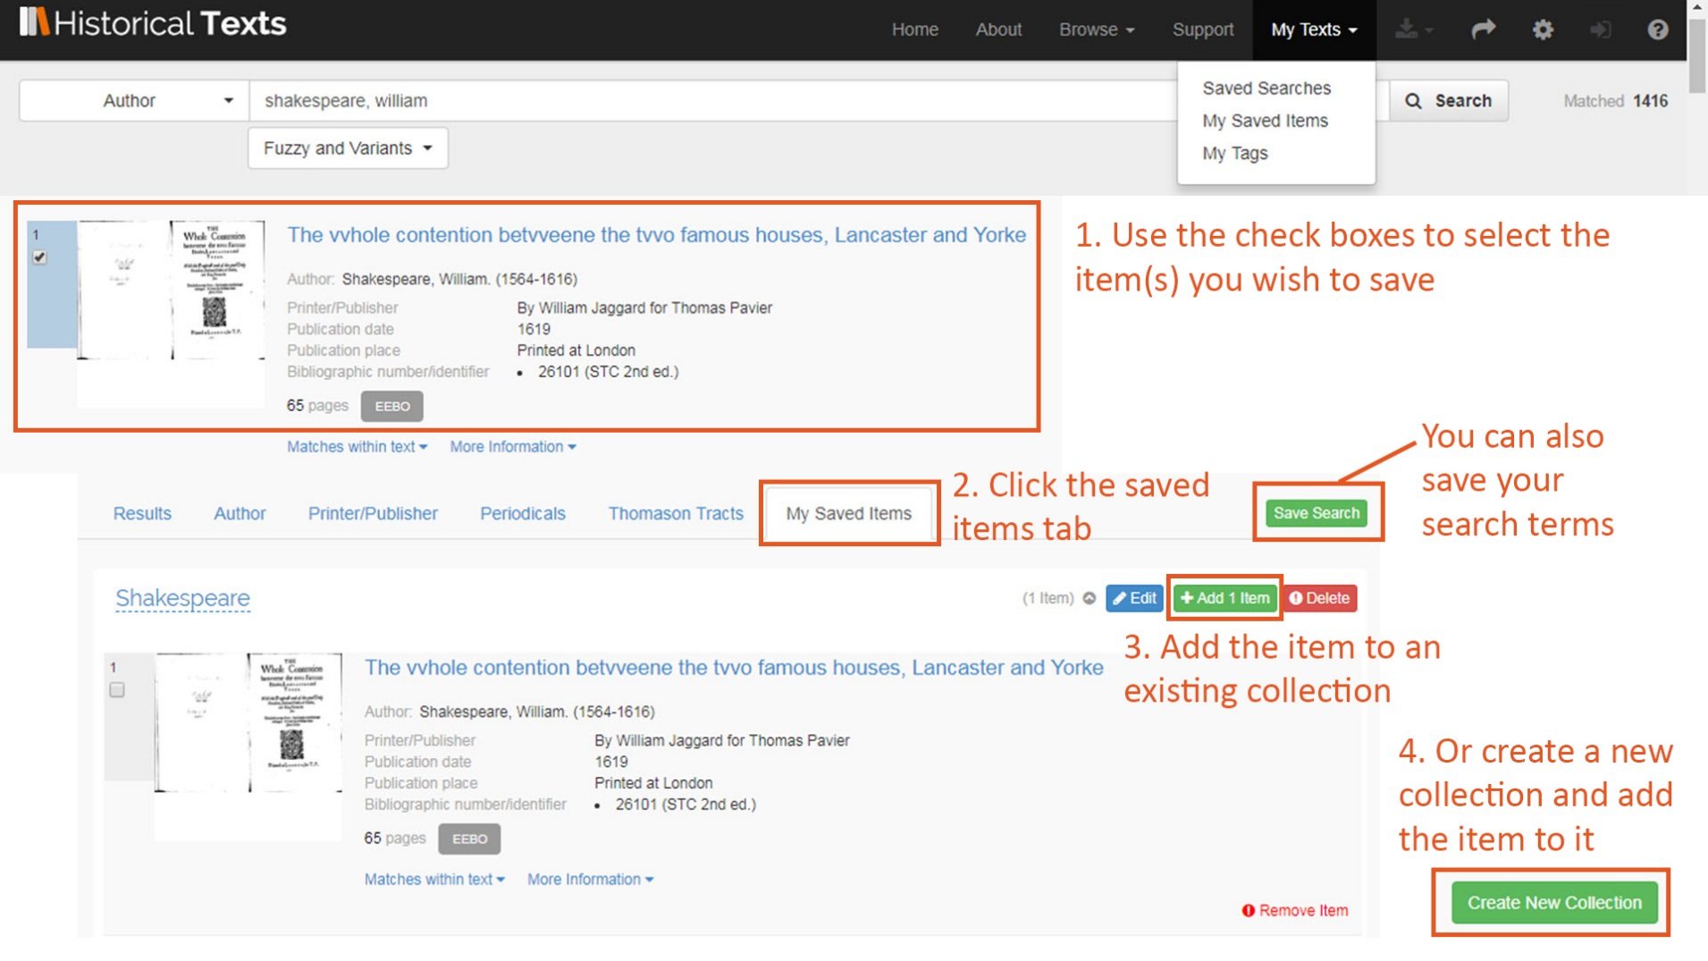
Saving items and search terms

Slide 15
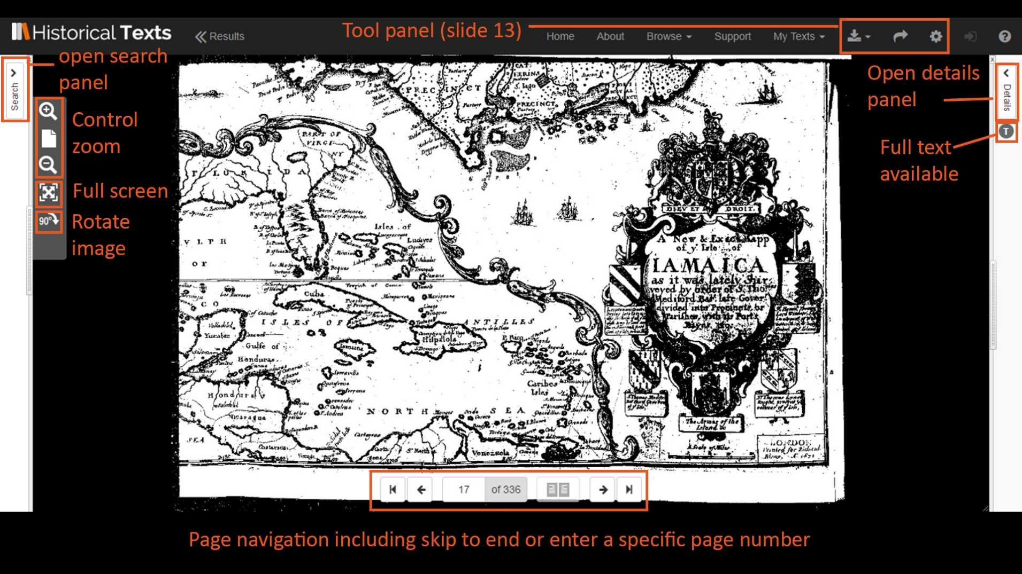
Viewer

Slide 16
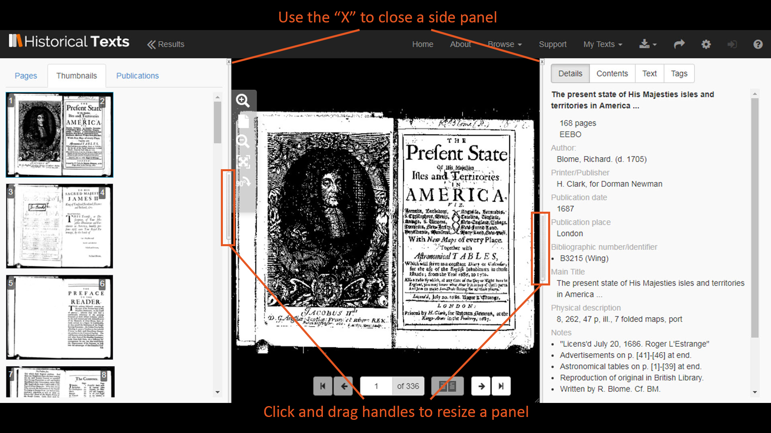
Viewer (side panels open)

Slide 17
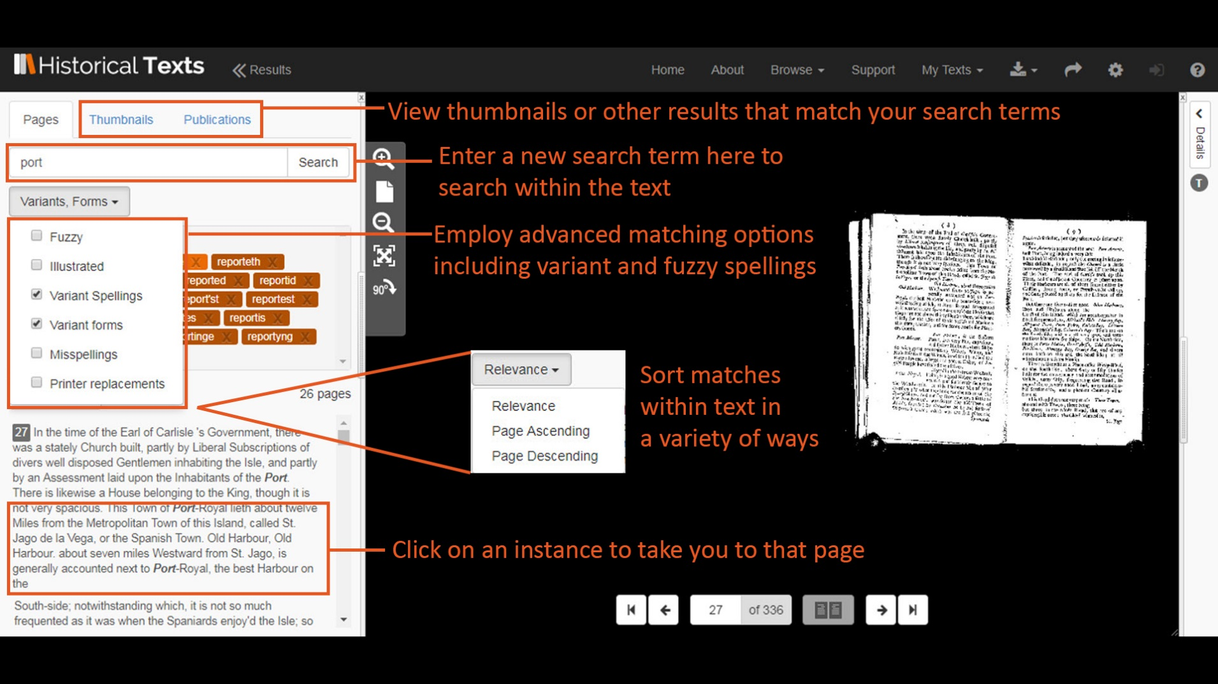
Viewer (search panel)

Slide 18
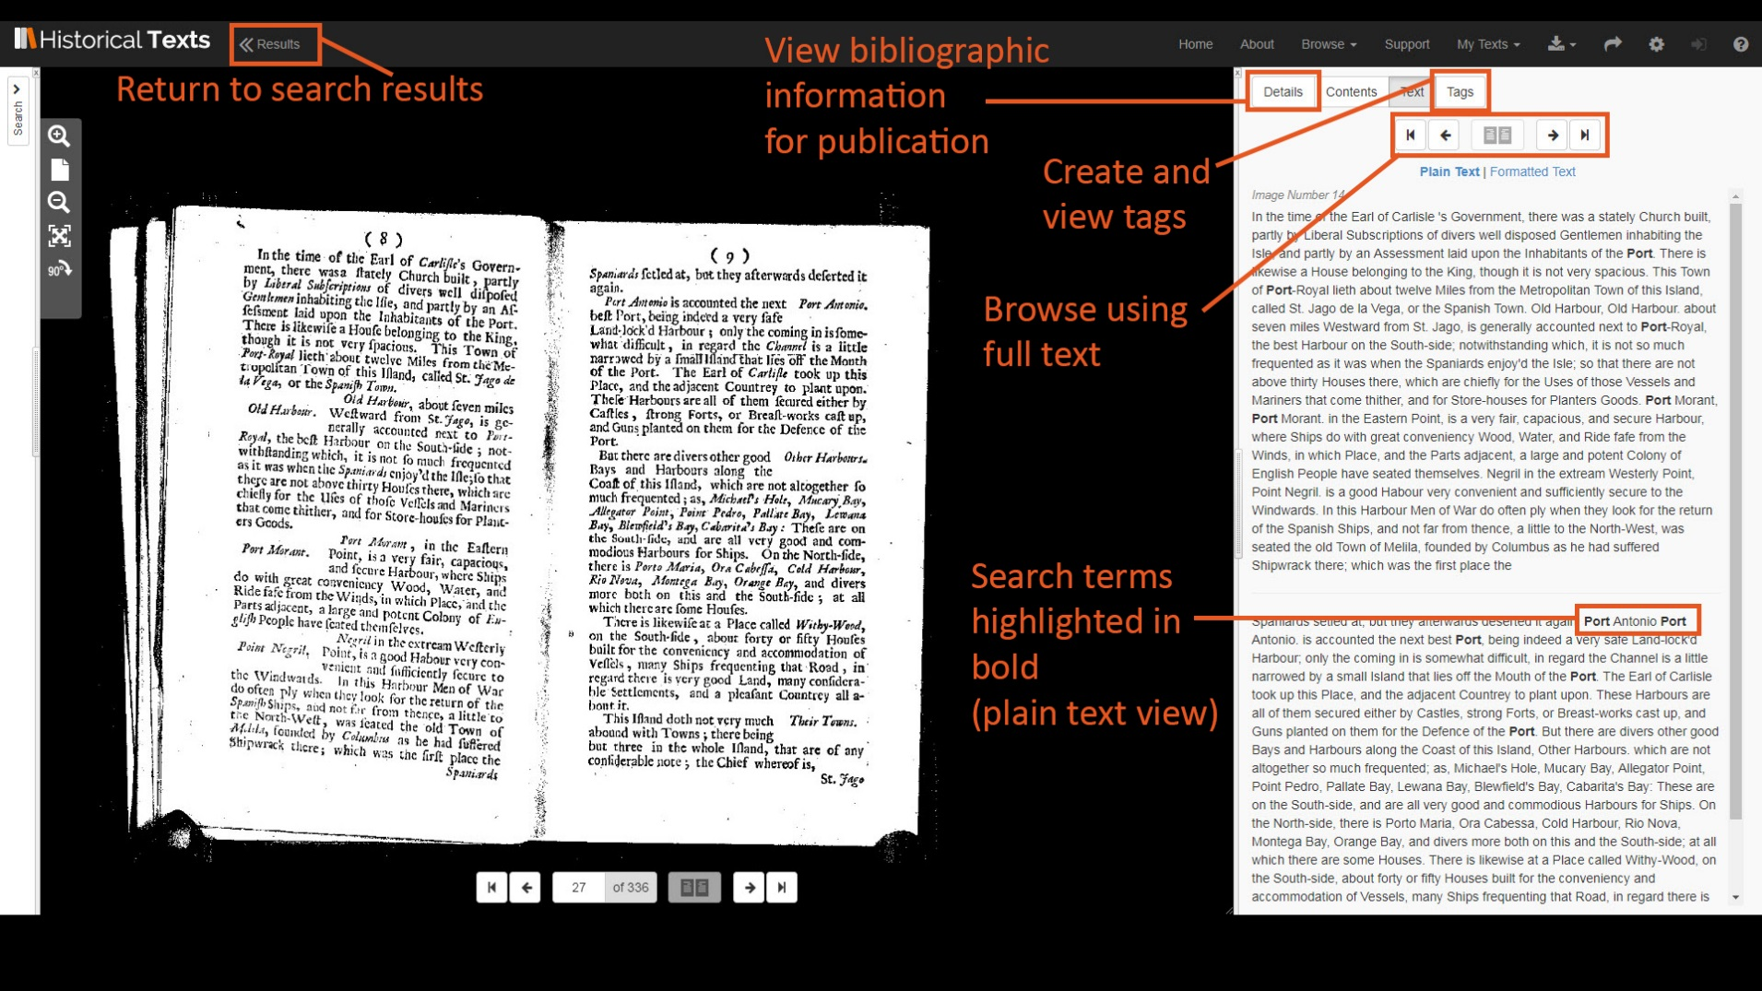
Viewer (details panel)

Slide 19
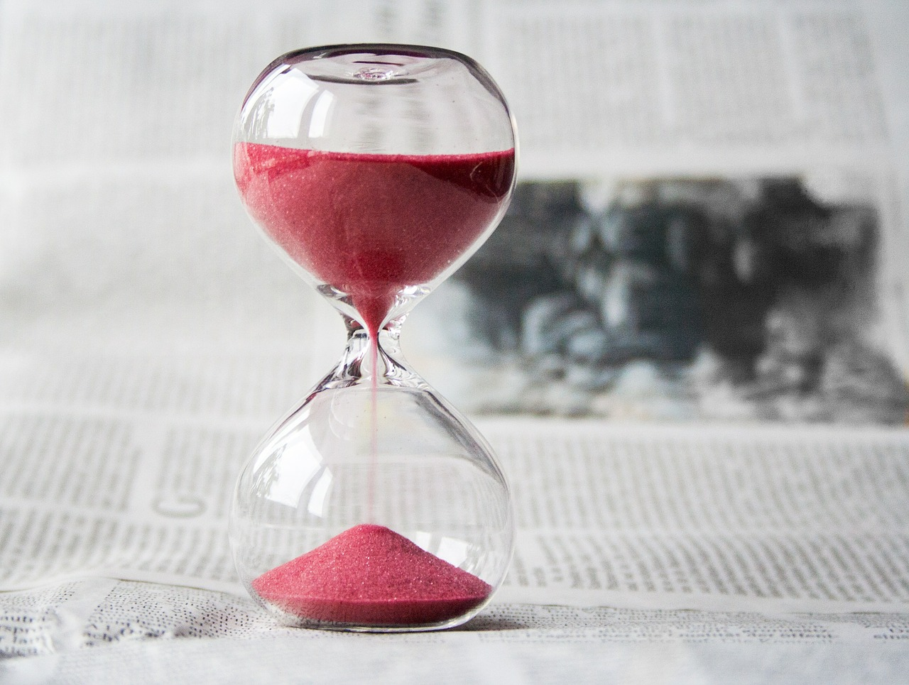
Benefits for researchers
Time saving – reducing need to travel to holding libraries to view texts
Access to rare and, in some cases, previously inaccessible texts
Full text searching across the 65,000 texts from the BL C19th collection for the first time
View ECCO full text for the first time
Cross search EEBO, ECCO, UK Medical Heritage Library and 65,000 BL 19th century texts in one place to quickly discover related material
View full text and images side by side for first time

Slide 20
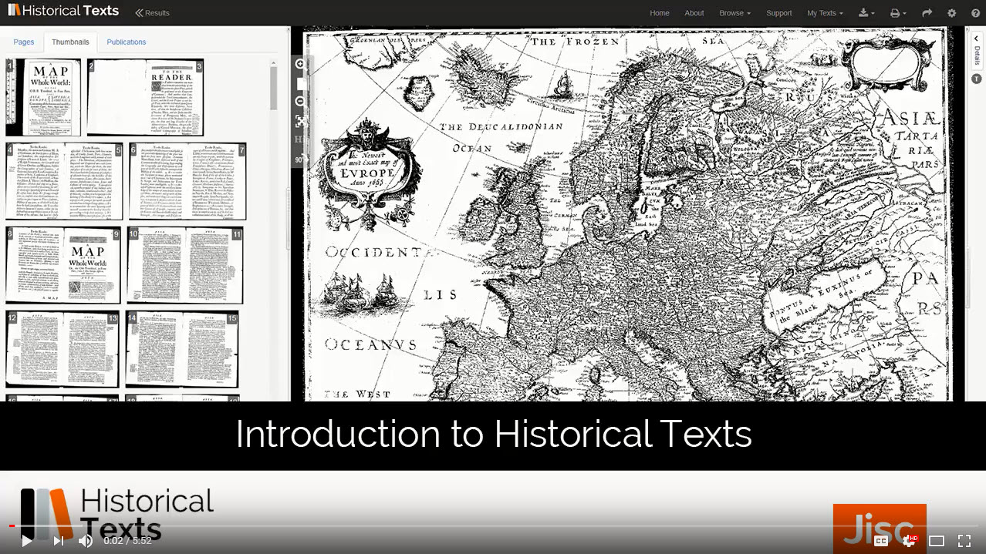
Further information
Website: http://historicaltexts.jisc.ac.uk
UKMHL Labs area: https://ukmhl.historicaltext.jisc.ac.uk
Support materials: http://historicaltexts.jisc.ac.uk/support
Development roadmap: http://historicaltexts.jisc.ac.uk/developmentroadmap
Helpdesk: historicaltexts@jisc.ac.uk

